Slide 1

Home
About
Content
Others
SALFORD
Express.
SELLERS
PERFORMANCE
ANALYSIS

Slide 2
Home
About
Content
Others
OUR JOB
The brand reputation is the foundation of trust for both customers and high-quality sellers.
The actions of individual sellers directly impact the perceived quality of the platform. Negative experiences lead to brand dilution and customer churn.
We have to understand sellers' behaviour to transition from a reactive to a proactive seller management model and implement a strategic framework to eliminate bad actors and empower good ones.

Slide 3
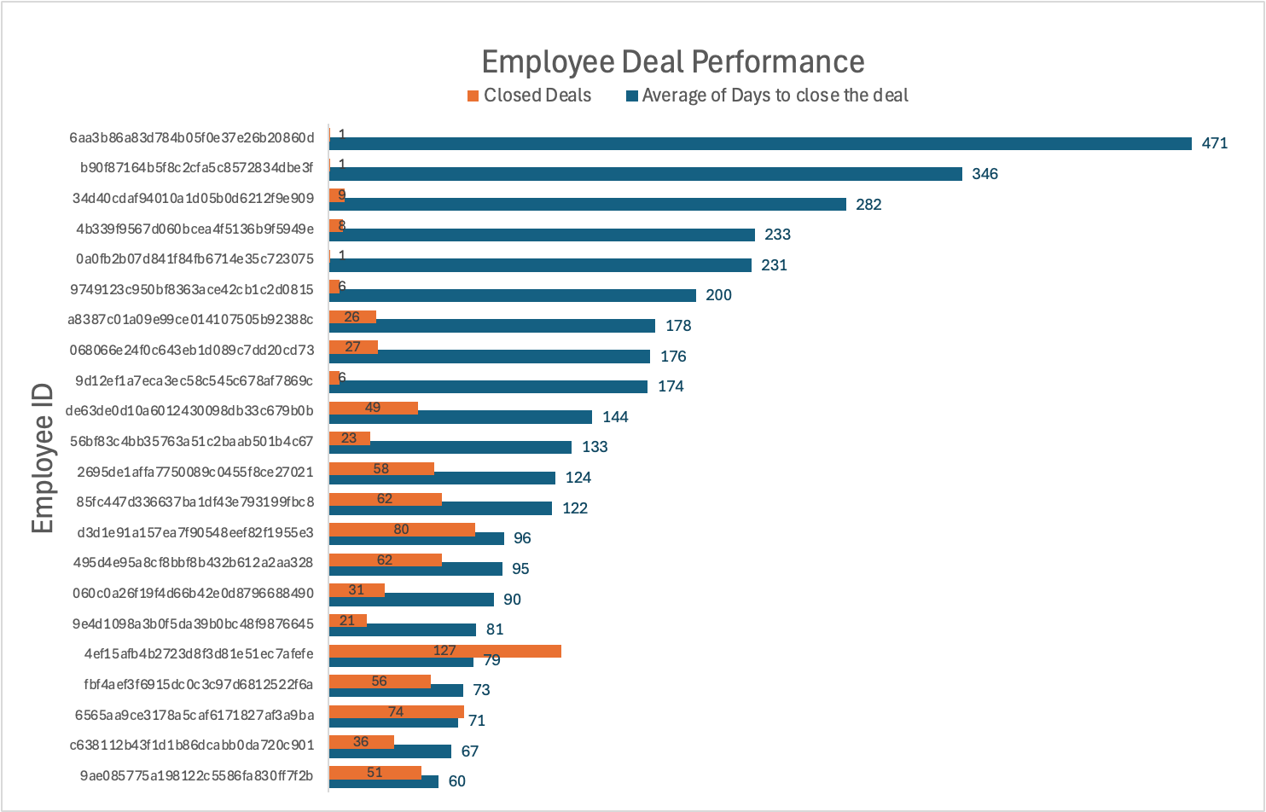
Home
About
Content
Others
2018
Total Deals
8000
Closed Deals
843
13%
of the total deals was closed

Slide 4
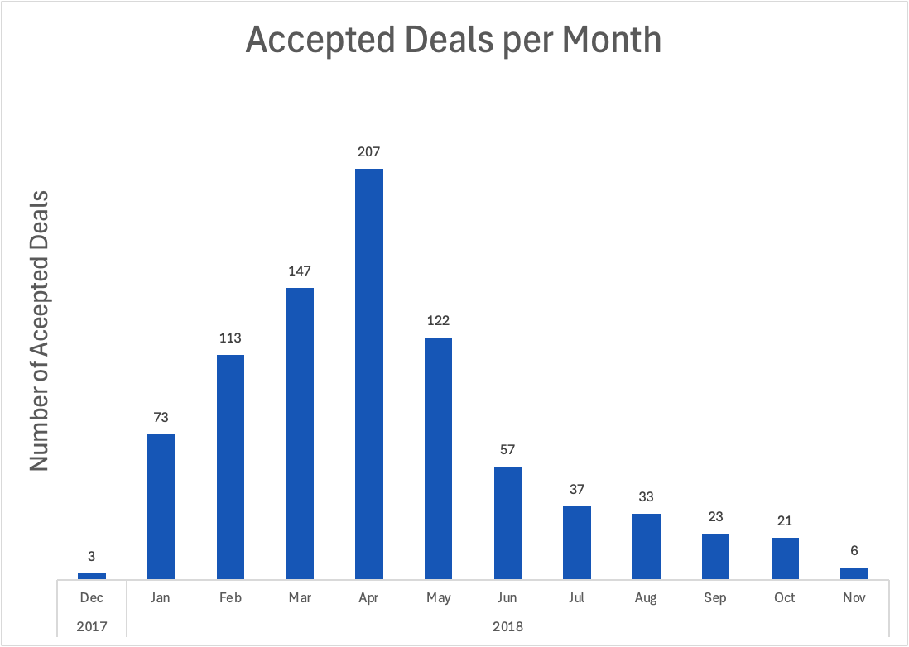
Home
About
Content
Others

Slide 5
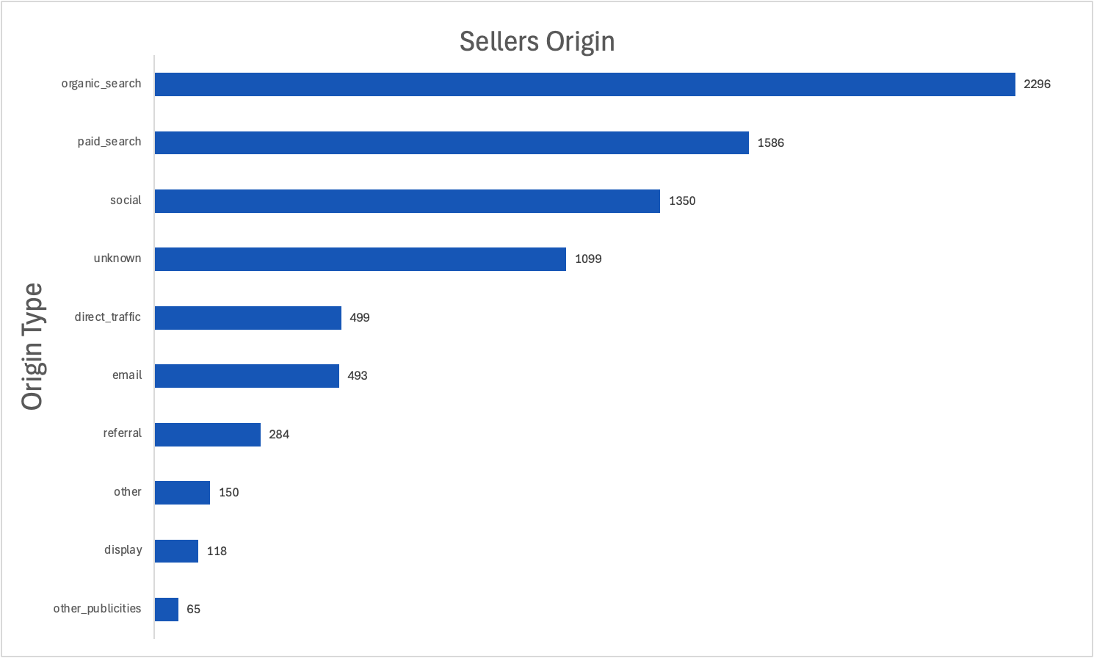
Home
About
Content
Others

Slide 6
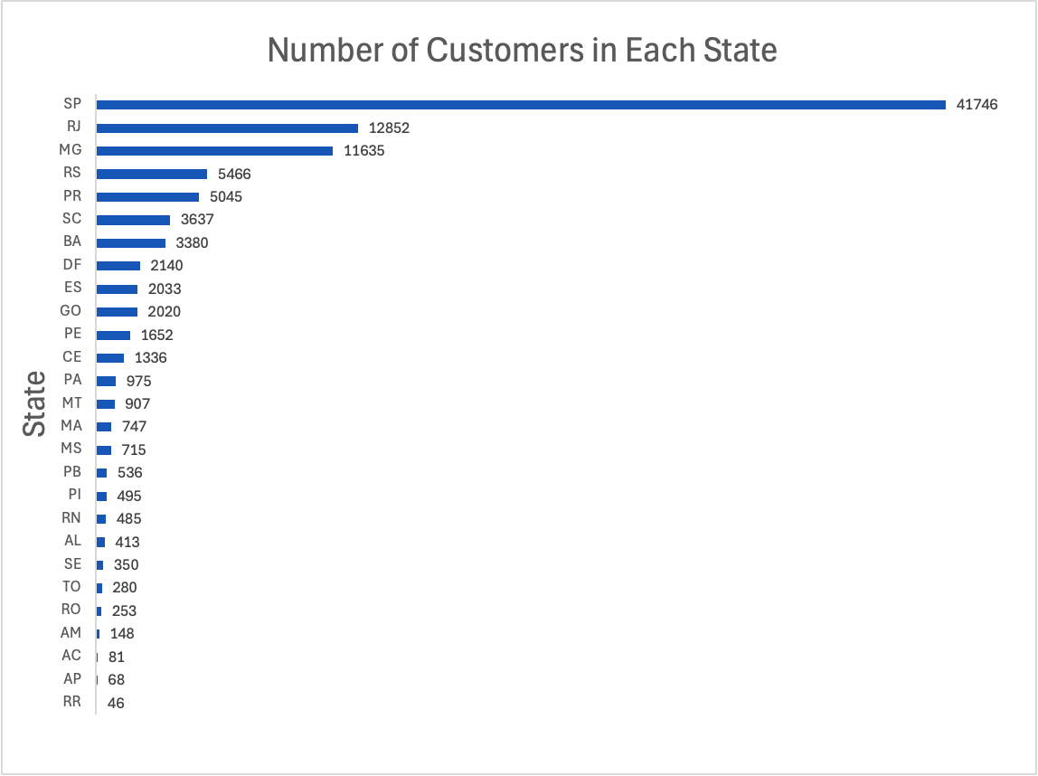
Home
About
Content
Others

Slide 7
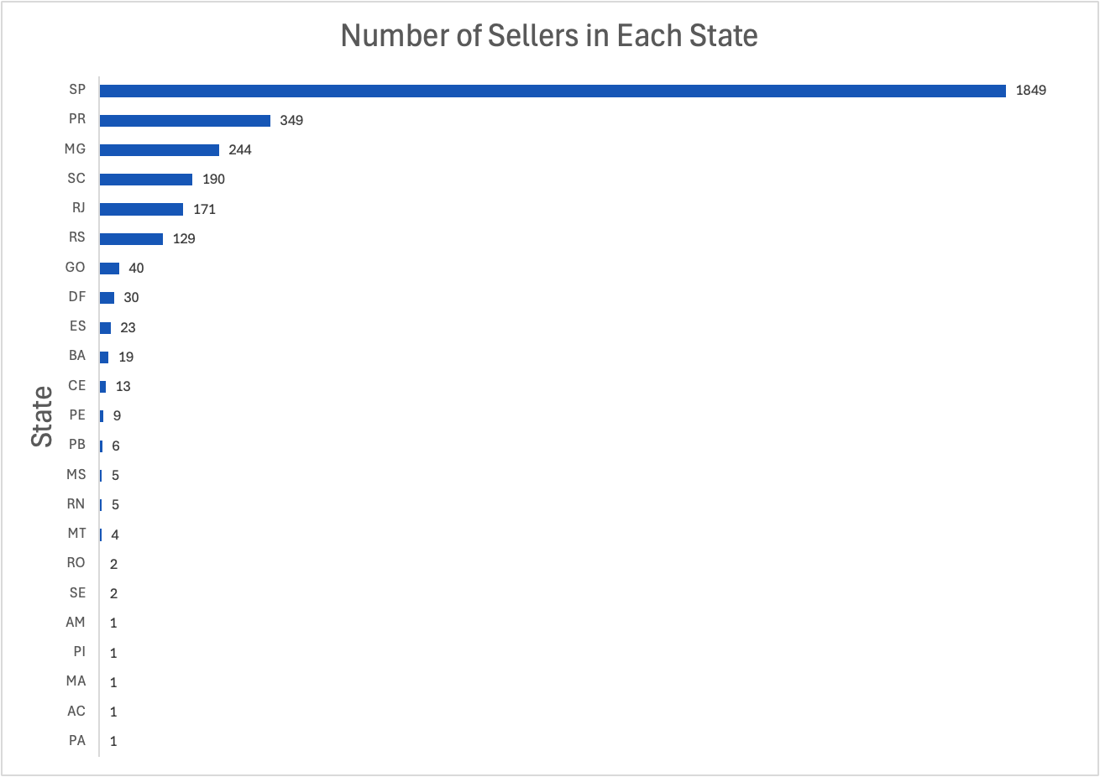
Home
About
Content
Others

Slide 8
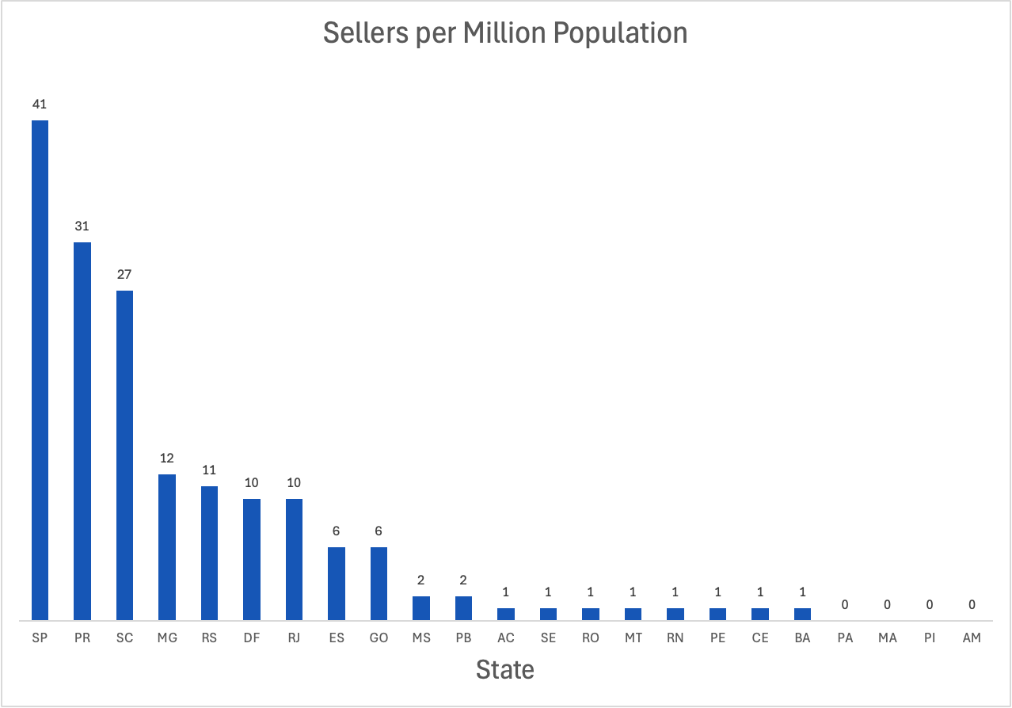
Home
About
Content
Others

Slide 9
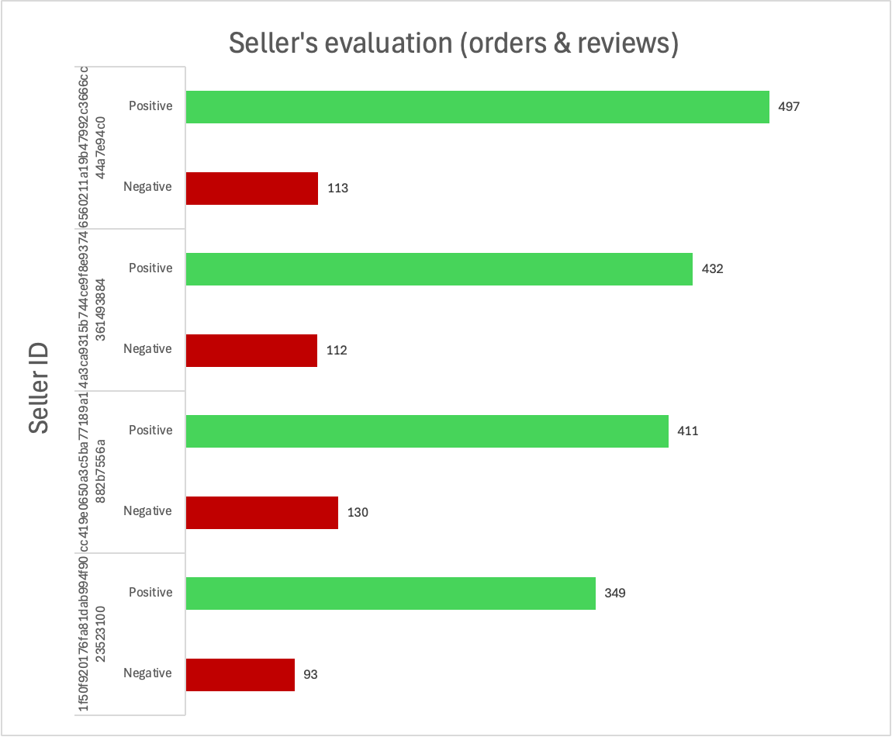
Home
About
Content
Others

Slide 10
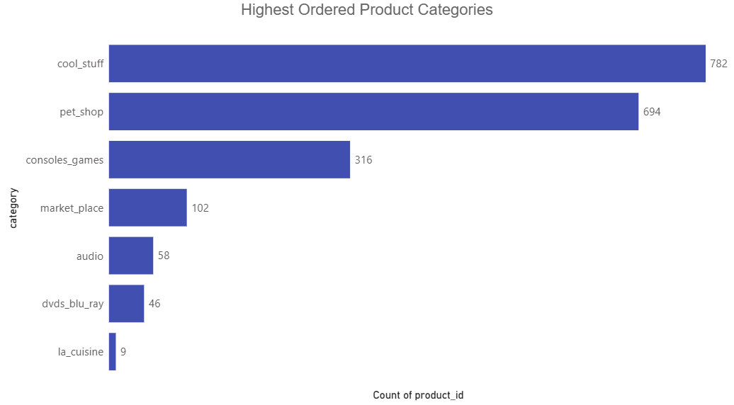
Home
About
Content
Others

Slide 11
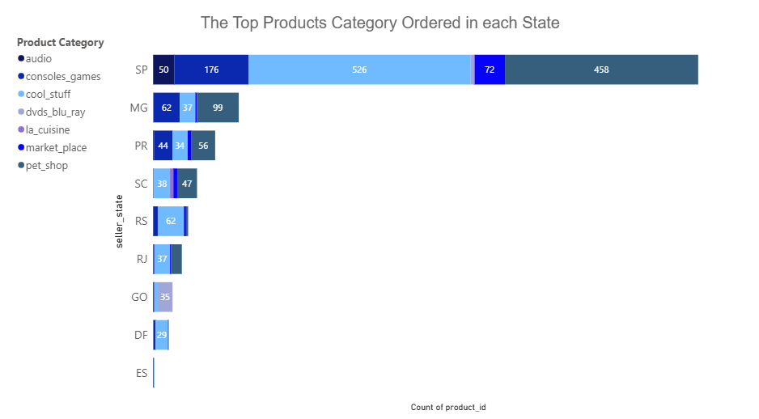
Home
About
Content
Others

Slide 12
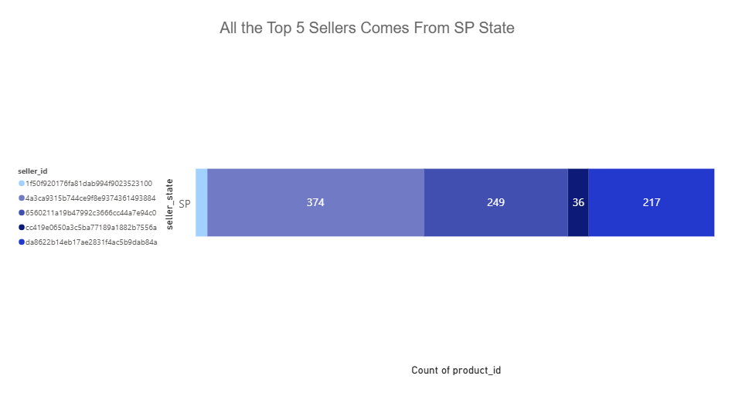
Home
About
Content
Others

Slide 13
RECCOMENDATIONS
Contact the Top sellers to become our brand ambassador
Recommend the highest demand products for new/low-seller states
Expand the sales team to drive faster deal closure
Increase the number of sellers in the least seller/population states

Slide 14
THANK YOU AND READY FOR YOUR FEEDBACK

